Slide 1
Bankarpt Online Banking
Magikarp inc.

Slide 2
General Description
Bankarpt Online banking is an online banking system that helps a bank account owner manage their own transactions with ease such as inquiring for their balance and make and review transactions, all in the aid of a desktop computer. It is a service that facilitates payments between accounts through online fund transfers. Our project aims to create a database application that will be in control of the activities being made on each financial record.

Slide 3
Basic Operation
As the user (Customer and Admin) opens up the website, they will be welcomed with a login screen given a choice to enter or register to the service which directs to the simplistic homepage if logged in successfully, if not then an error will appear and to the registration page if registered is chosen. If the End User lands to the home page, it shows you what you want to do with your account / finances, whether you want to make or view a transaction, add, send or receive fund or log out. If the Admin lands to the home page, it shows you want to do with End User accounts, own account, view End User transactions or log out.

Slide 4
Information Needs
Users are free to check their account information whenever they want such as their transaction history and contacts.
Transaction History: Transaction ID, receiver, sender, amount, date/time.
The transaction history shows the details of all transactions made within the account in a chronological order.
Make a transaction: Receiver, Desired amount.
The website offers a feature where you can make transactions with any person you wish as long as they also have a Bankarpt account.
Admin: Delete and Edit Customer Transactions and Delete Account
An Admin aids the Customer and Bank with their ability to manage the system.

Slide 5
Functions
The website has five (5) functions: Add, Edit, Delete, Search, Filter and General Report.
Add functionality registers: Customer Details to the Customer Account, Admin Details to the Admin Account and Bank Details that will be submitted in the database which will be shown, altered, deleted and filtered in a webpage
Edit alters certain and several details from Customer Account, Admin Account and Transaction.
Delete removes: Customer Account, Admin Account and a specific Transaction Detail
Search functionality shows the result of a specific entered keyword in a transaction e.g. Transaction Date, Transaction ID, Transaction Amount, Sender and Receiver.
Filter lists the result in a descending or descending manner of Transaction
General Report functionality shows the overall Transaction which includes Transaction ID, Transaction Date, Transaction Email and Transaction Amount

Slide 6
Pages
The website, Bankarpt Online Banking will have four (12) pages having Admin and Customer Log-in Page, Admin and Customer Register Page, Admin and Customer Home Page, Customer Transaction Page, Customer Fund Page, Customer Account Details Page, Contact us Page, Forgot Page and Customer Edit Account Details Page.

Slide 7
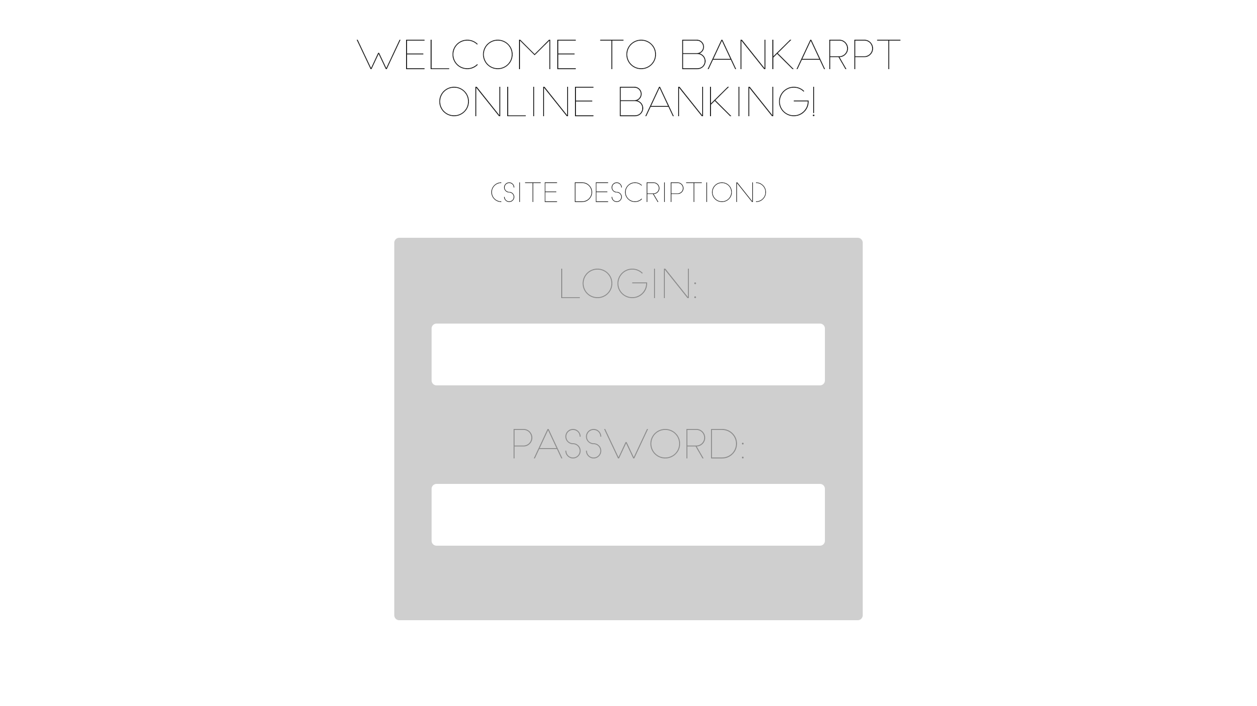

Slide 8
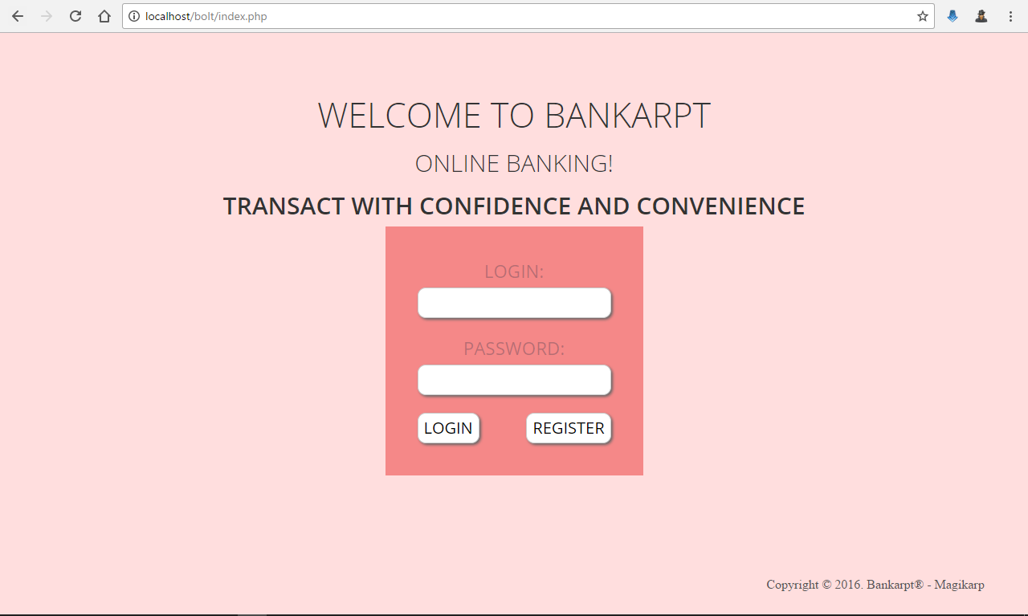

Slide 9
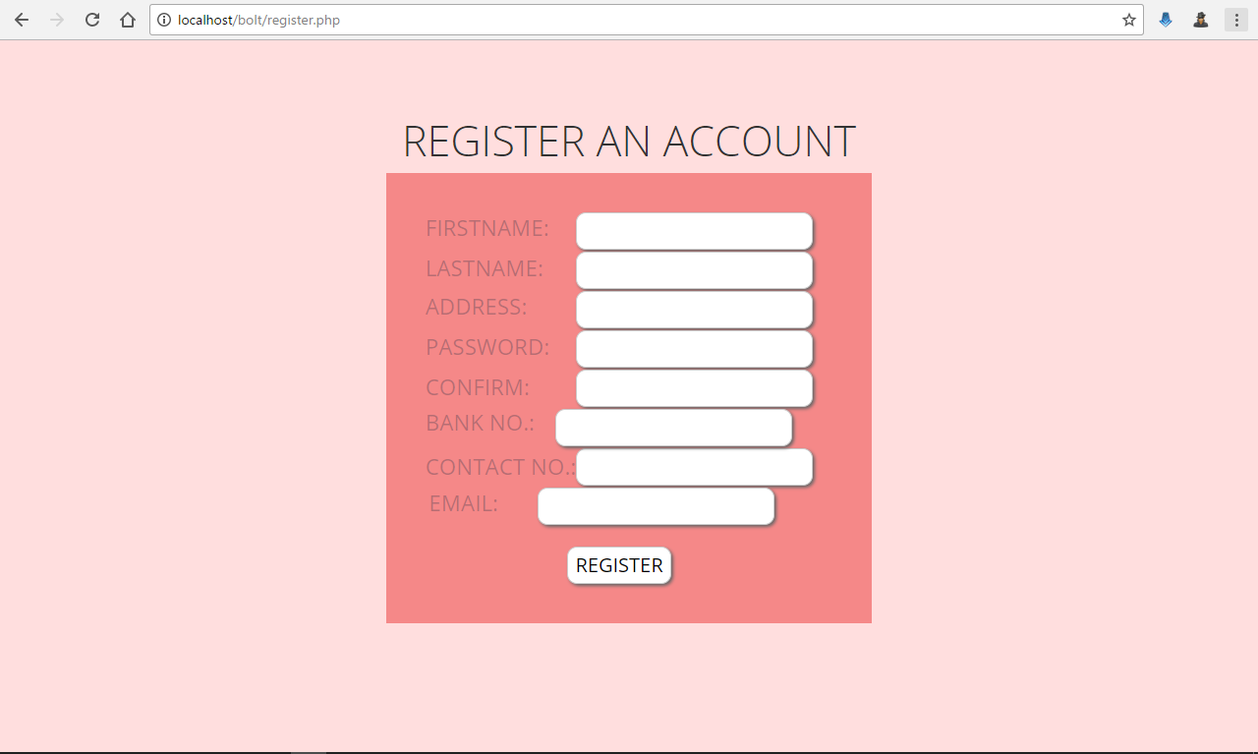

Slide 10
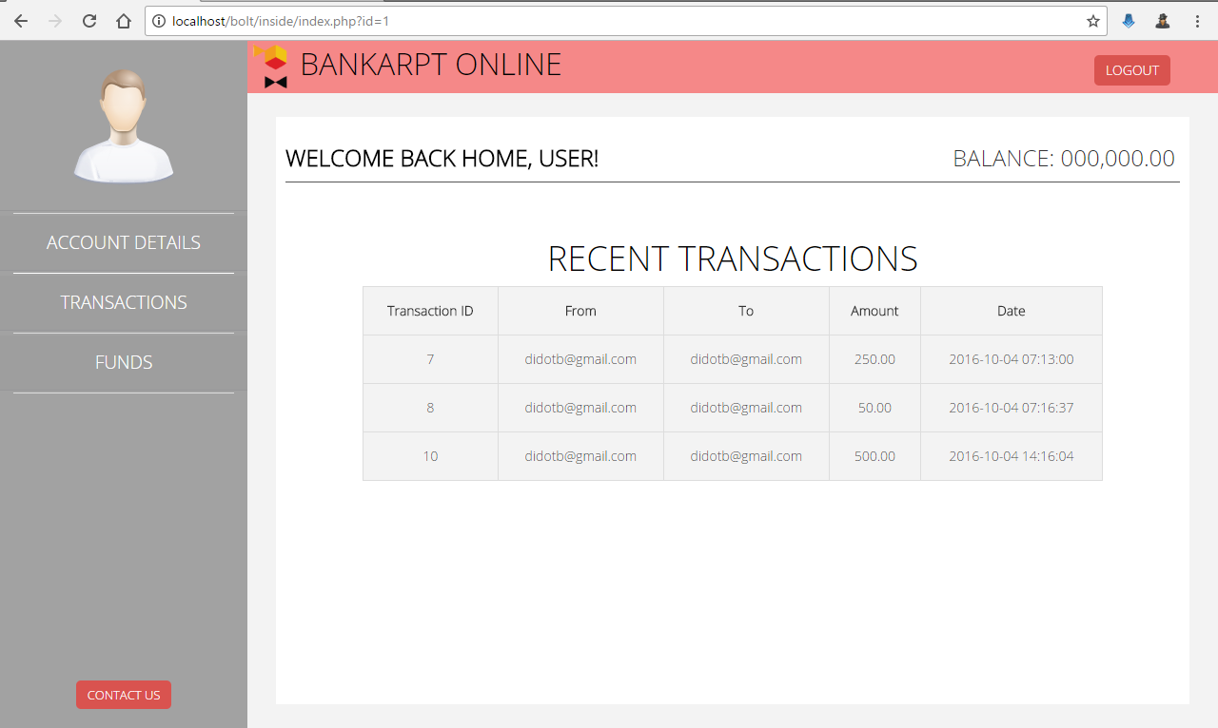

Slide 11
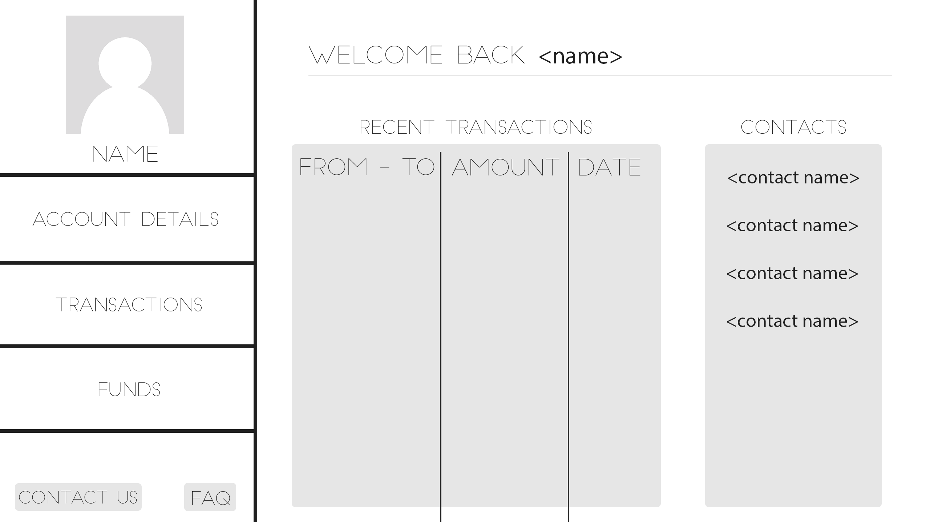

Slide 12
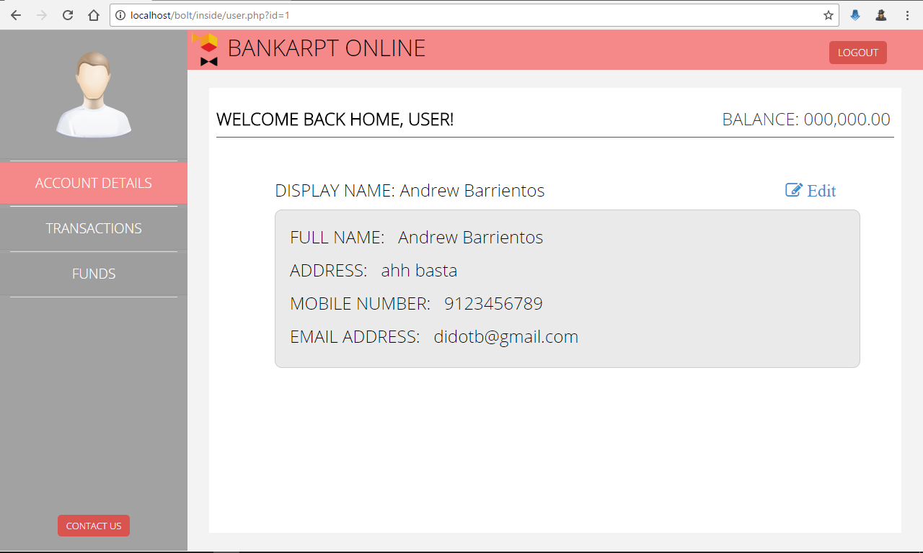

Slide 13
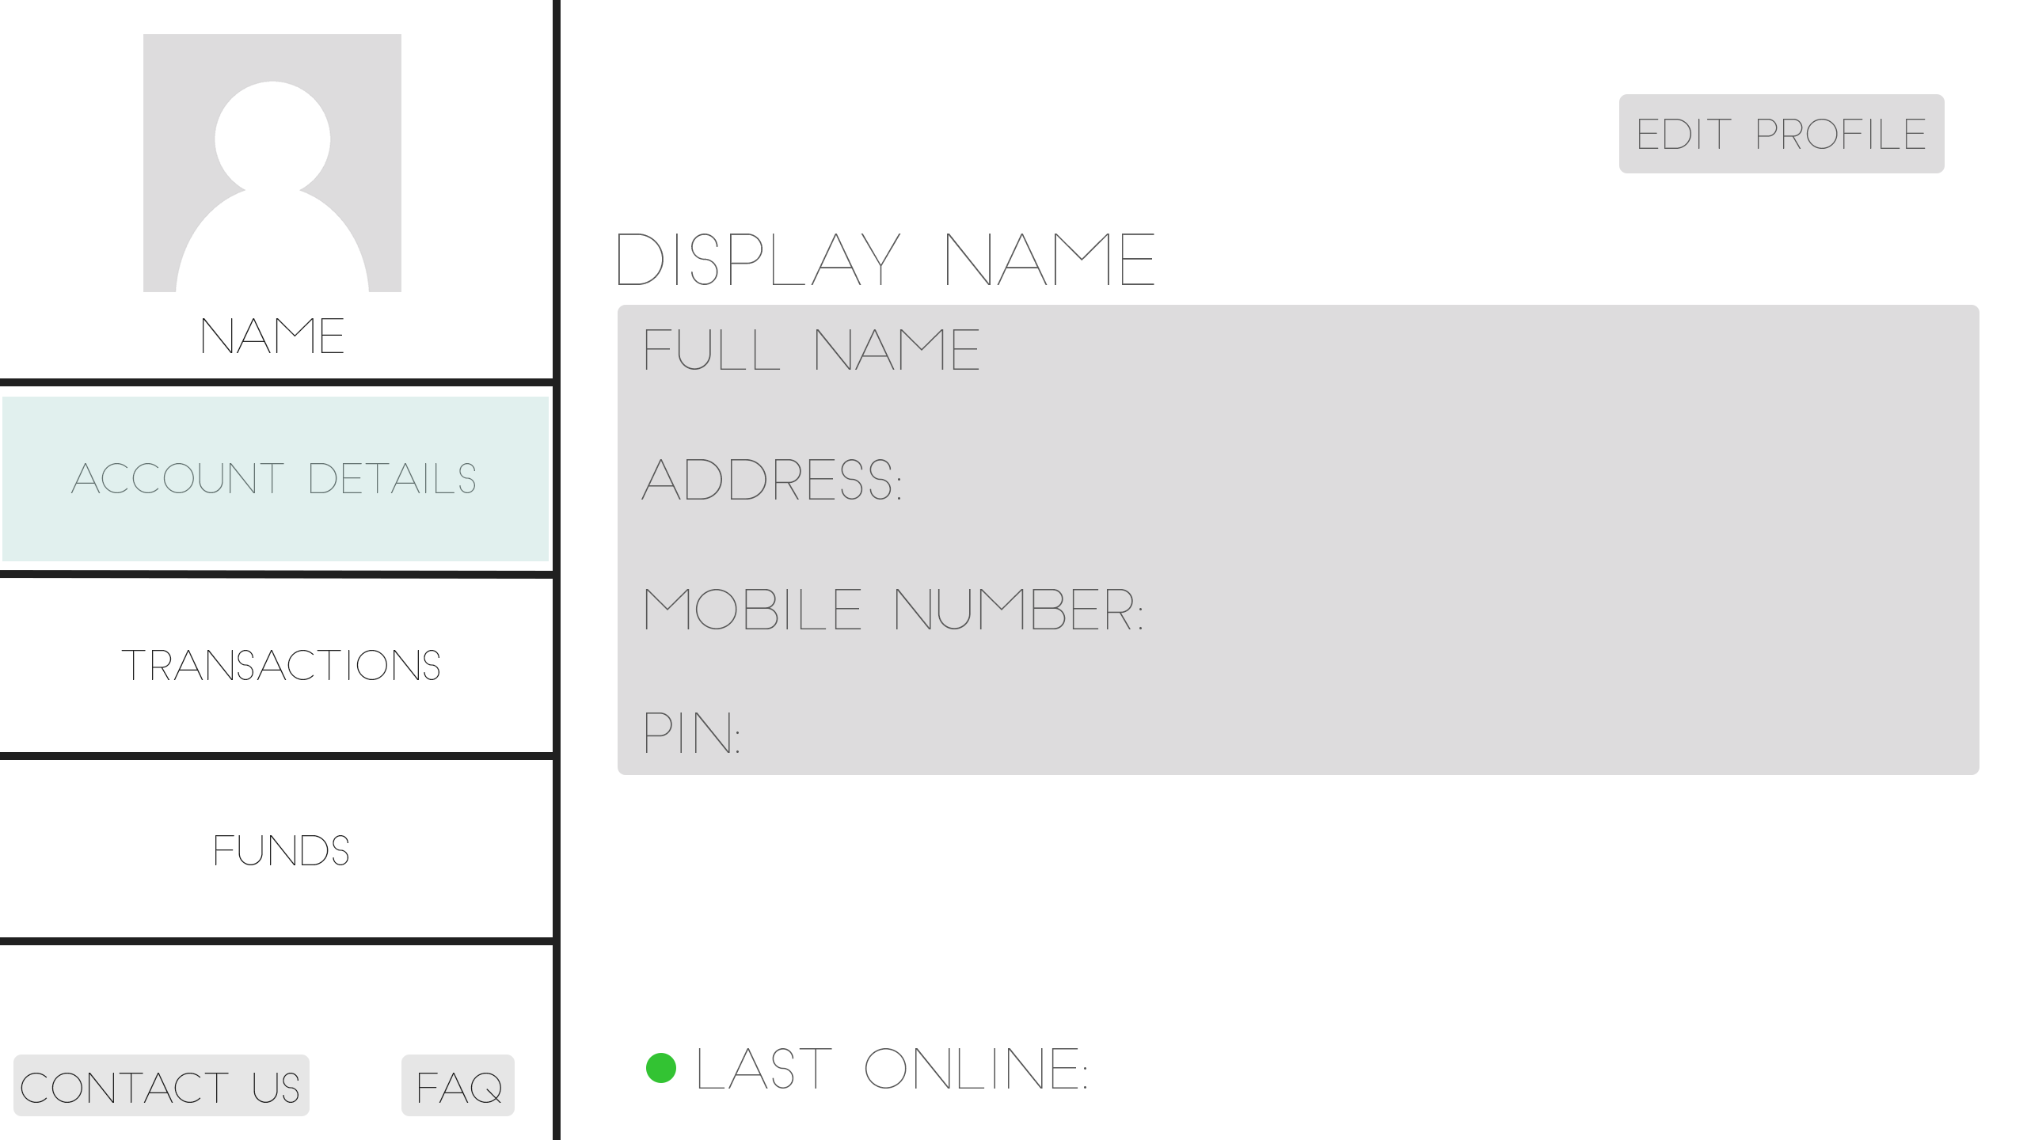

Slide 14
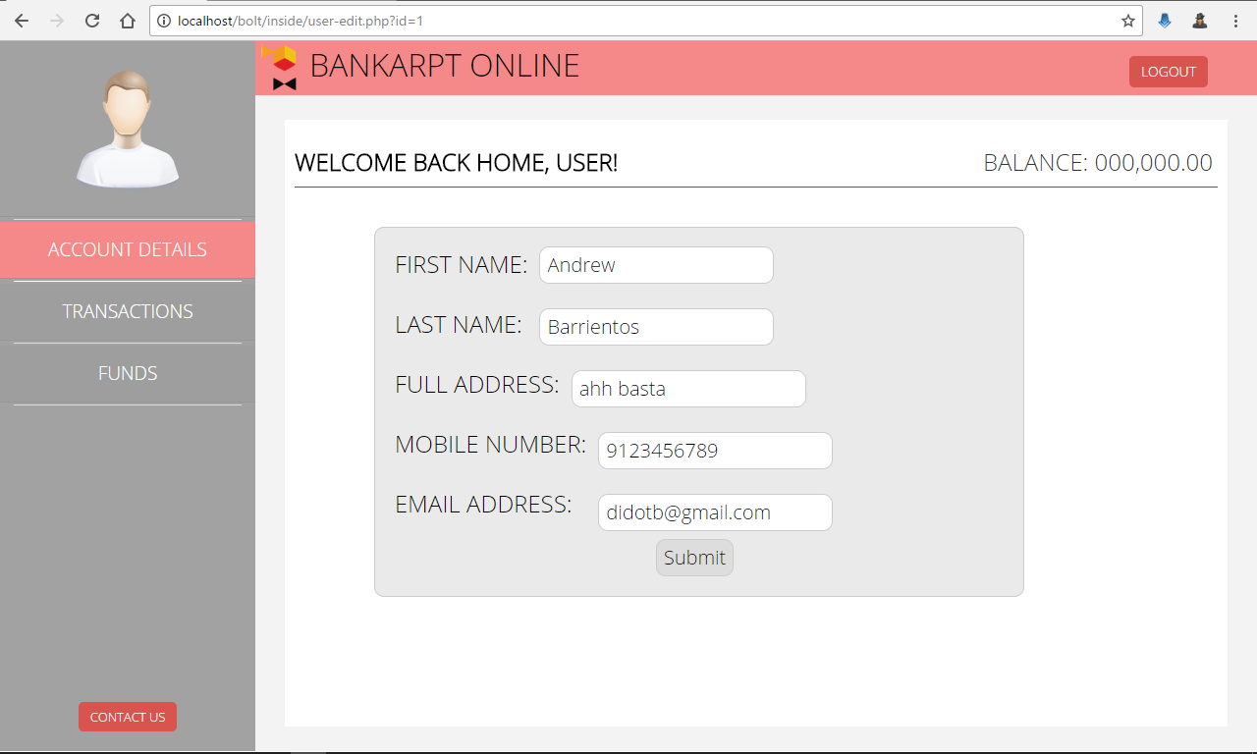

Slide 15
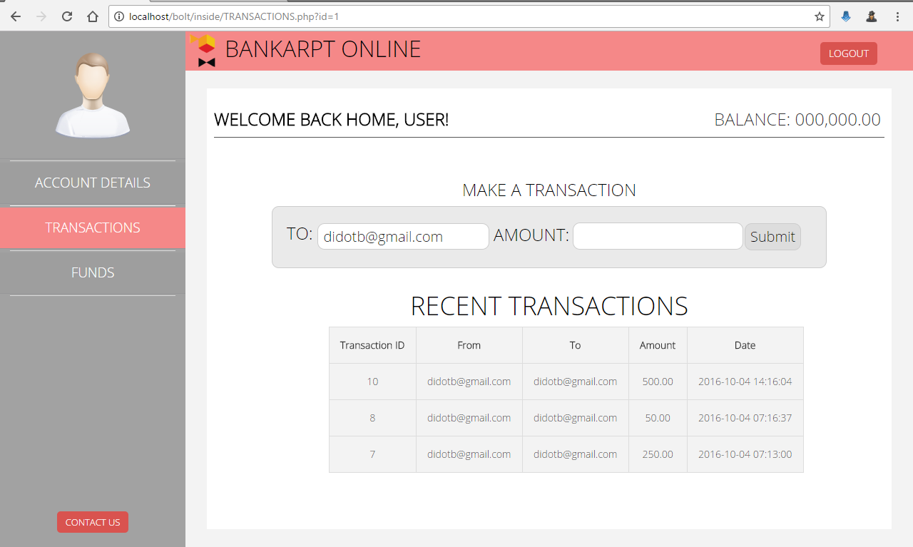

Slide 16
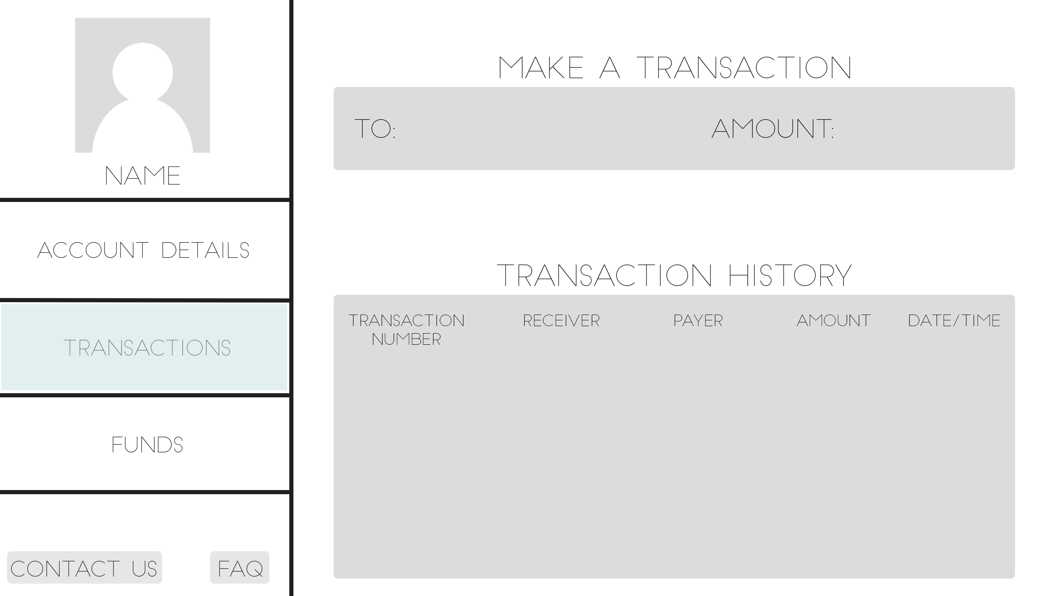

Slide 17
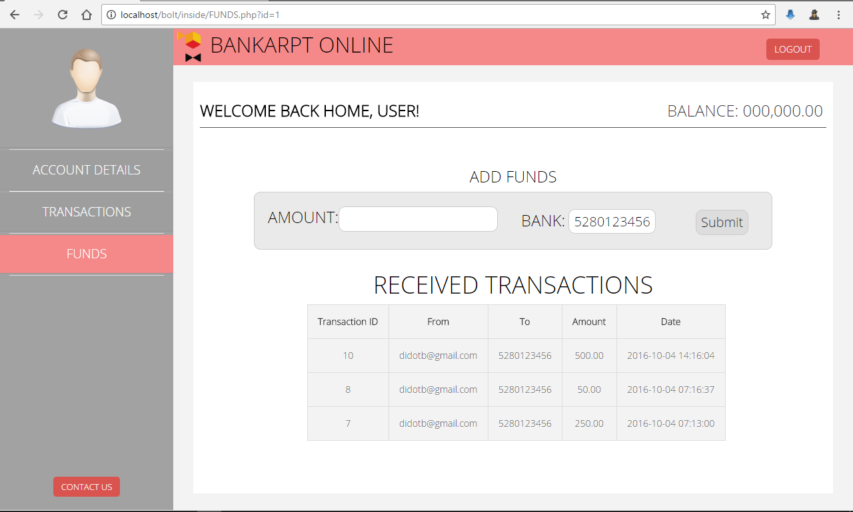

Slide 18
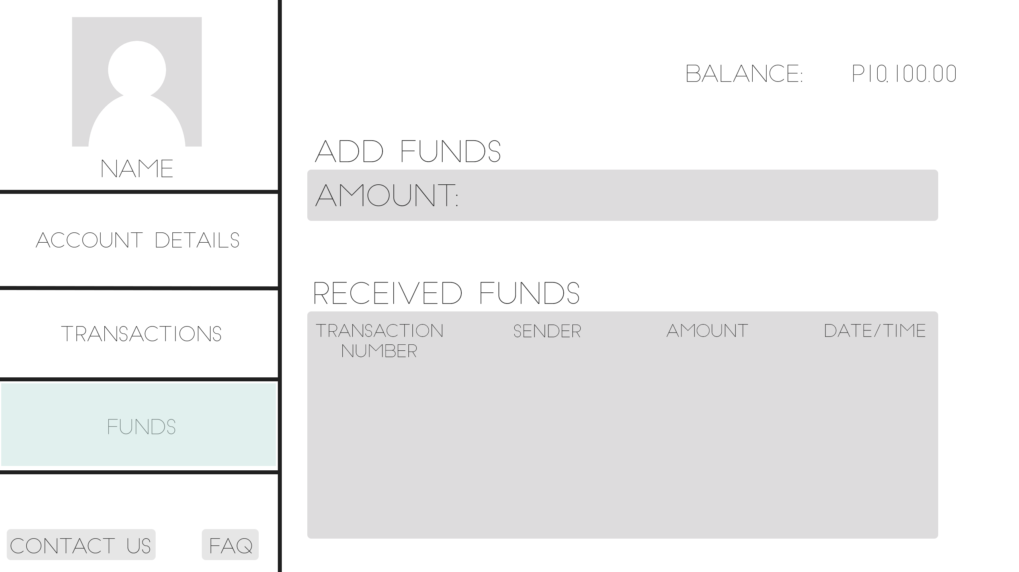

Slide 19
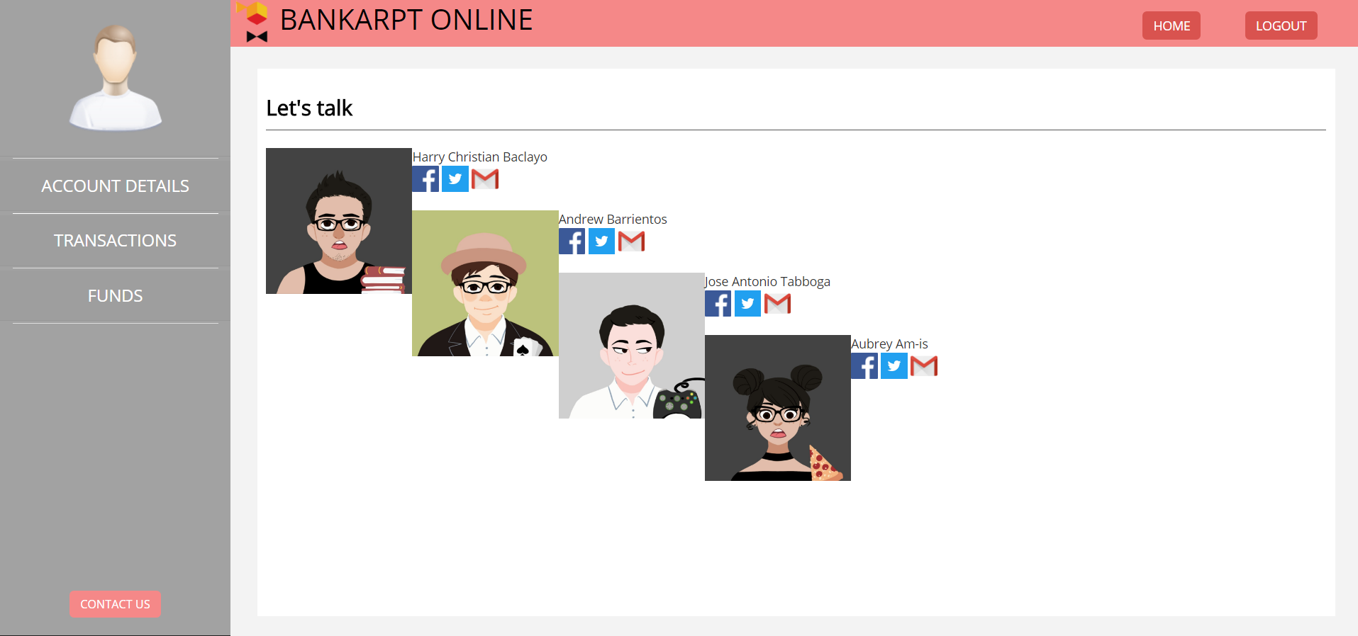

Slide 20
Objectives
Personal Bank transactions can effortlessly be found.
Accounts and Records are be secured.
Accessible through desktop

Slide 21
Boundaries
Not accessible if there is no internet connection
Requires a recent desktop computers
Funds can’t be used to shop online

Slide 22
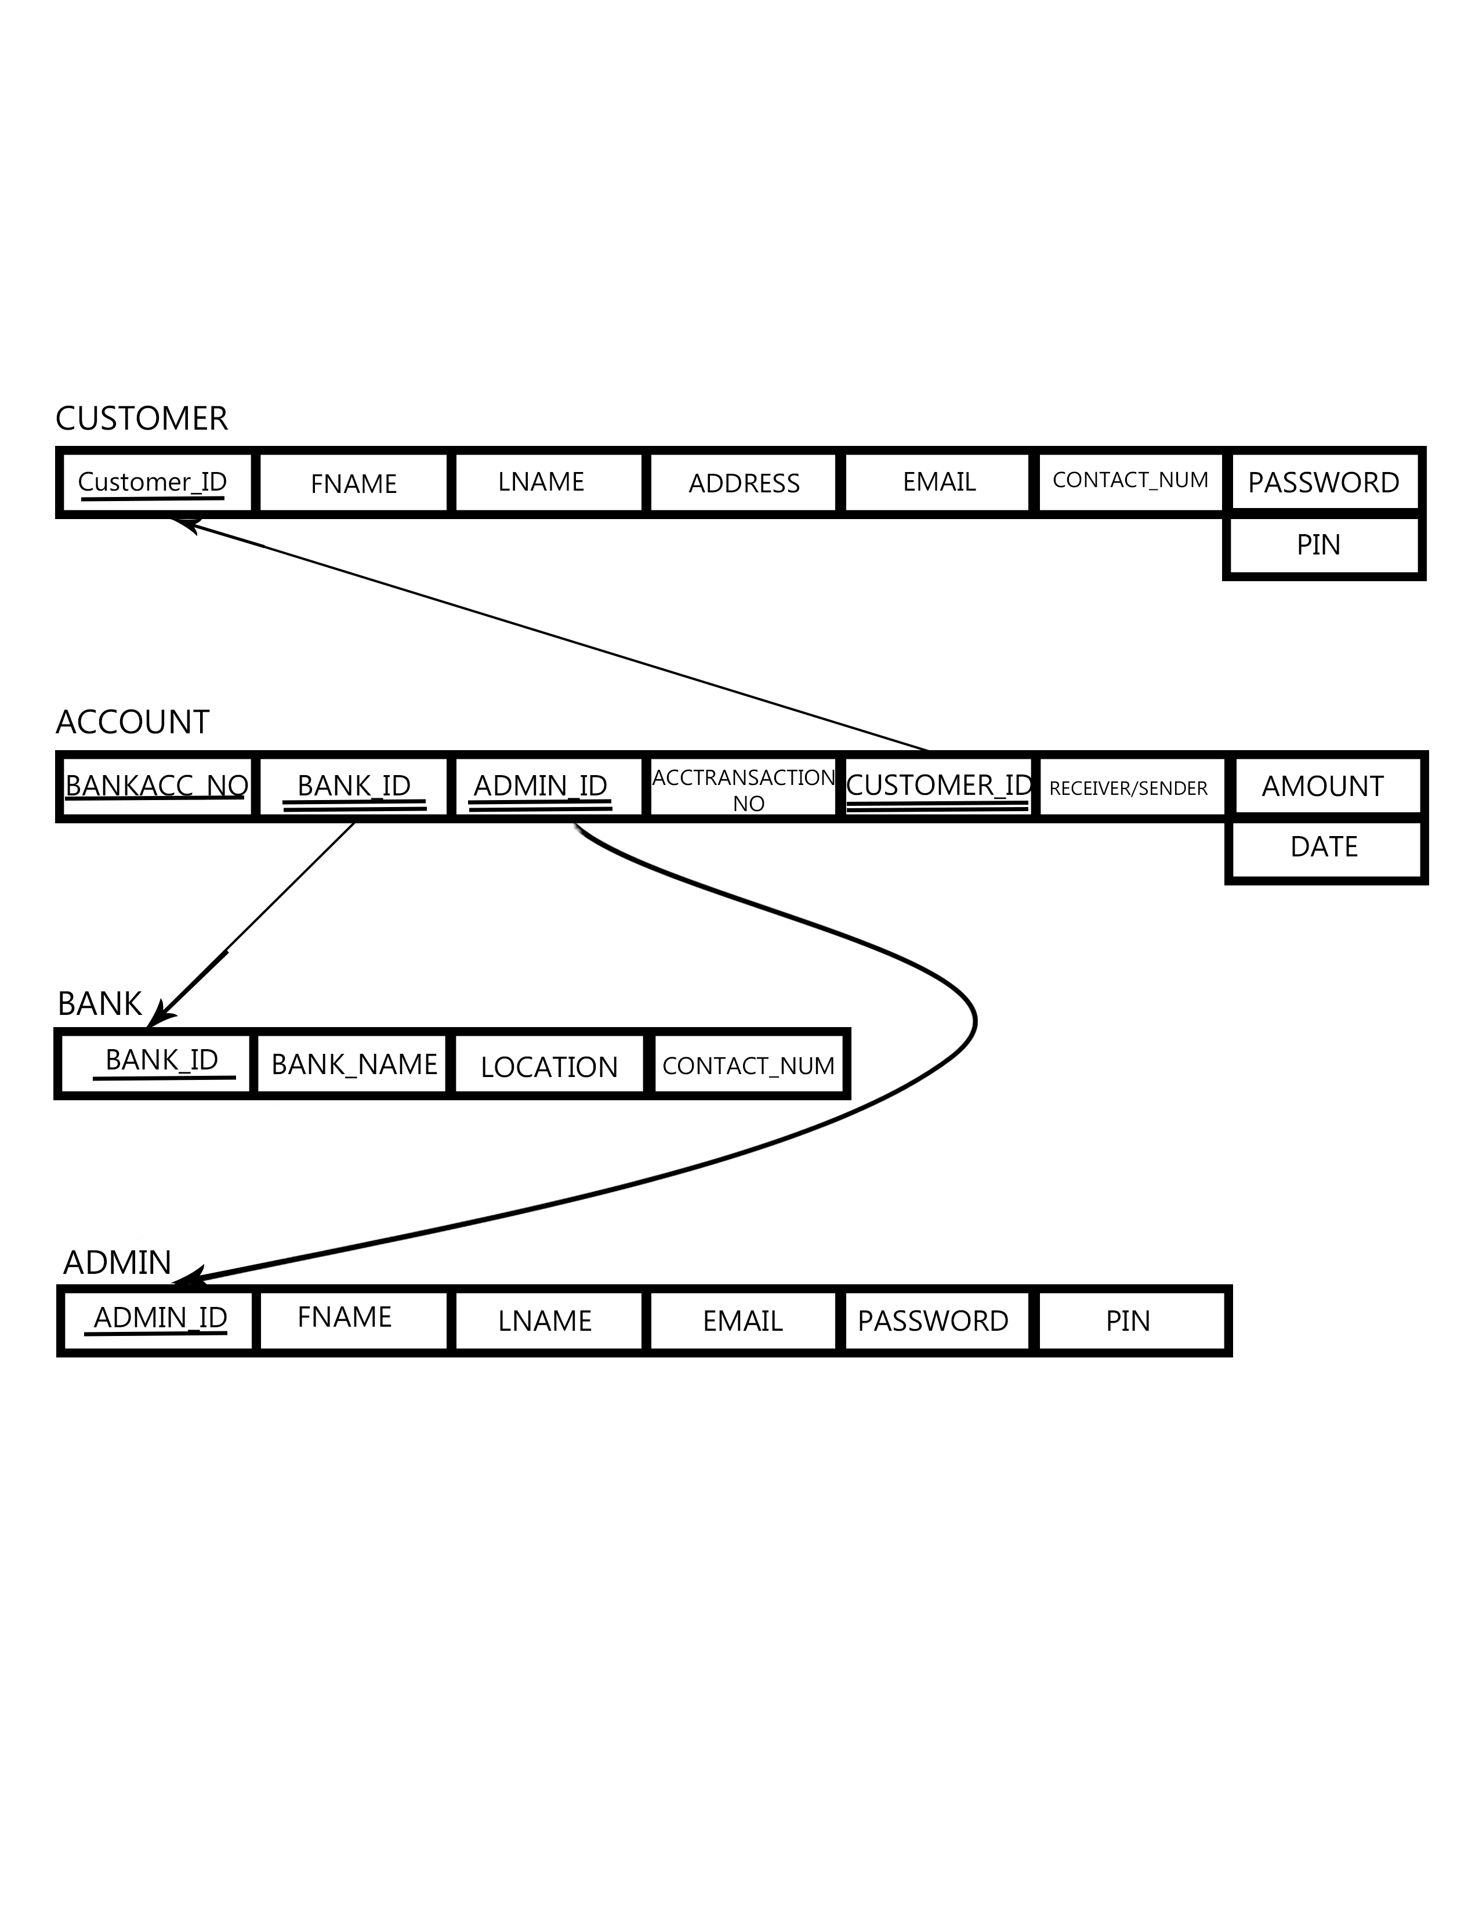
Relational Mapping

Slide 23
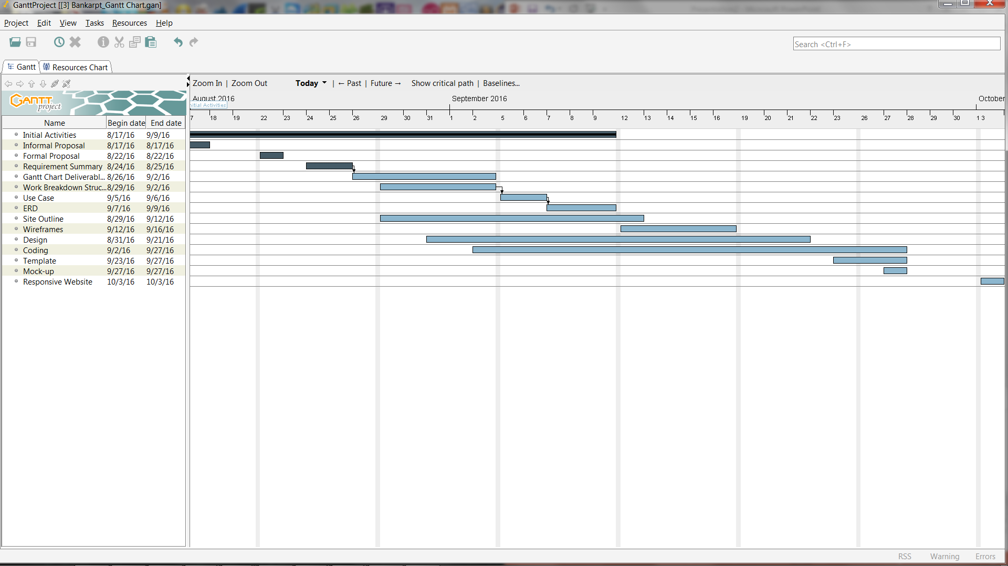
Gantt Chart

Slide 24
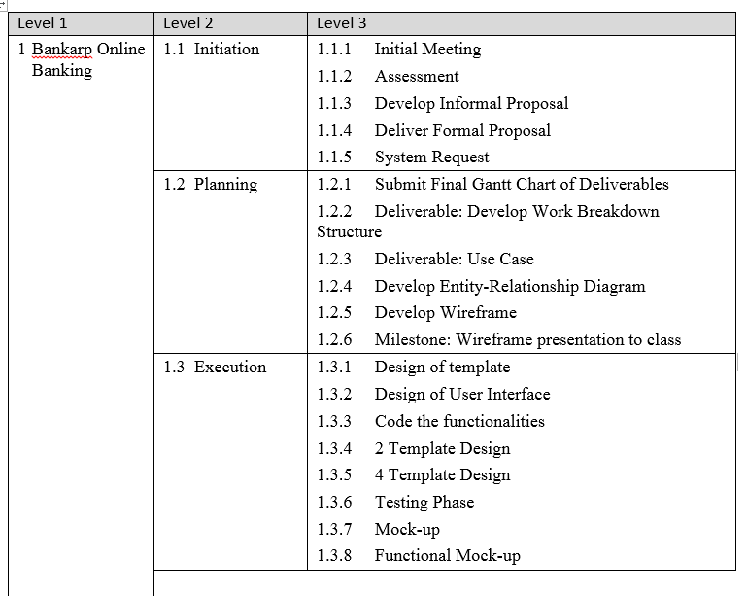
Work Breakdown Structure

Slide 25
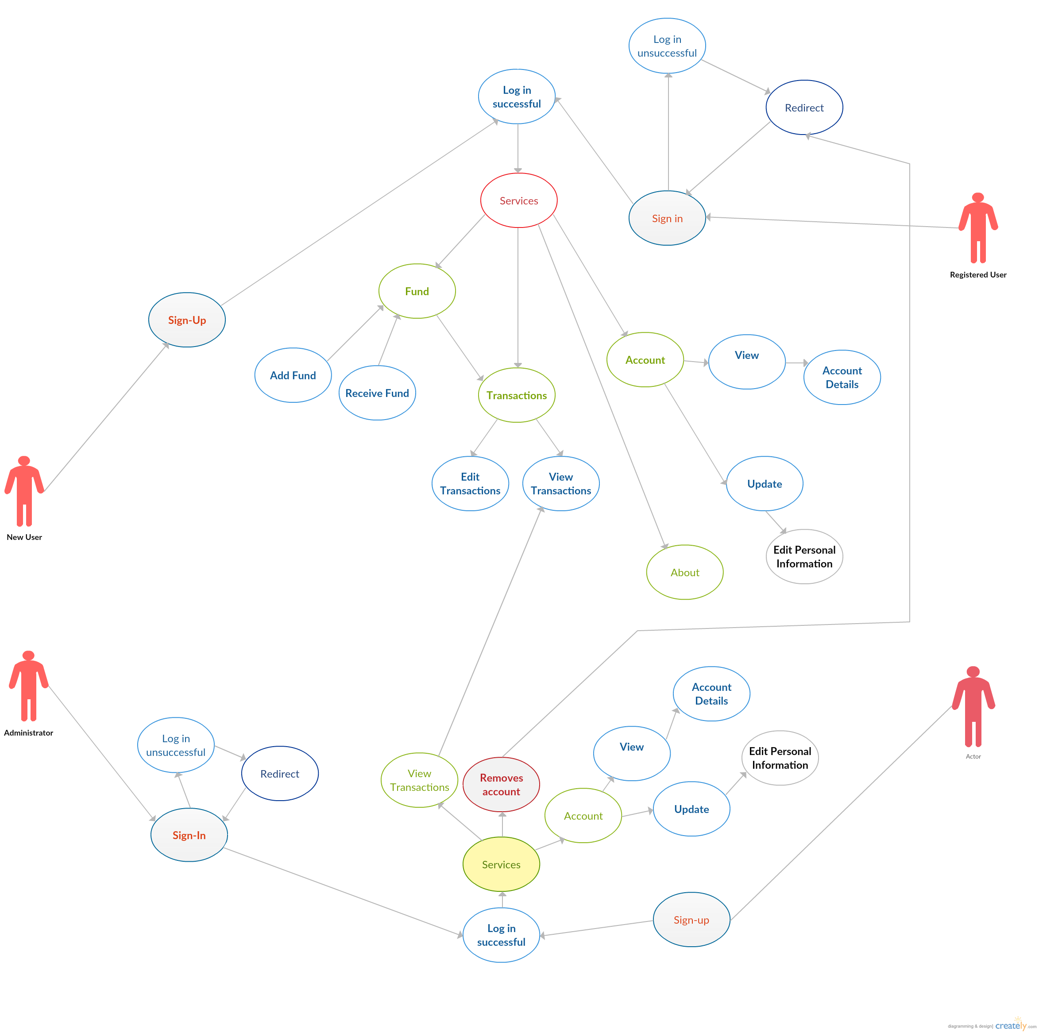
Use Case

Slide 26
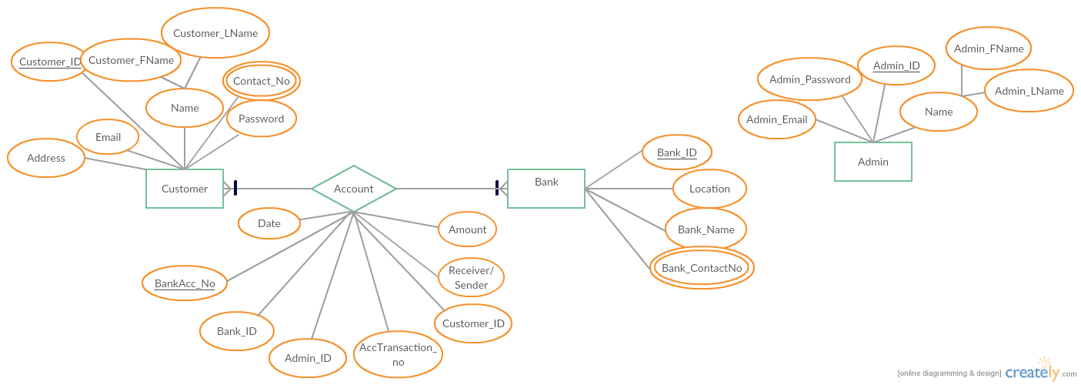
ERD

